Slide 1
WeAllocate:
A resource optimizer for a better tomorrow
Group 3: Bilal Naseer, David Cardenas, Daniyal Khan, Umar Khan

Slide 2

Who?
Serves urban communities of Chicago
Community Engagement
Food and Wellness Center
Promote health and growth
Partner with others
Notes:
Bilal:
IMAN is dedicated to serving urban communities, addressing deep-rooted issues of systemic poverty, and seeking social change through comprehensive community development
The organization employs a holistic approach to community building, integrating aspects of health, arts and culture, and leadership development.
Community Engagement: IMAN's initiatives are deeply rooted in the principle of community collaboration,
The IMAN Food and Wellness Center promotes health and wellness to local residents. They partner with the Greater Chicago Food Depository to bring a “client choice” food distribution 3 days a week as well as organize soup kitchens and community events

Slide 3
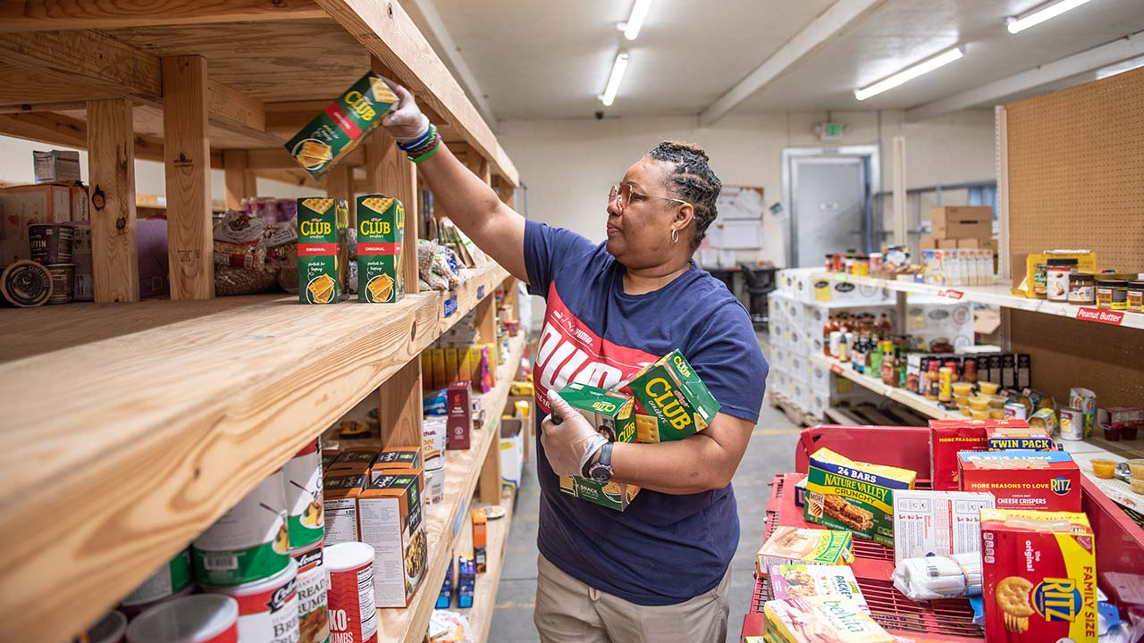
Purpose of WeAllocate
Challenges Addressed for IMAN.
Unpredictable demand
Perishable item wastage
Maximizing resource impact
Improve resource management in charitable food distribution
Enhance resilience, efficiency, and impact
Strategic Partnership with IMAN
Leveraging expertise and resources for success
Pioneering a movement by Revolutionizing charitable food distribution systems
Notes:
Our purpose

Slide 4
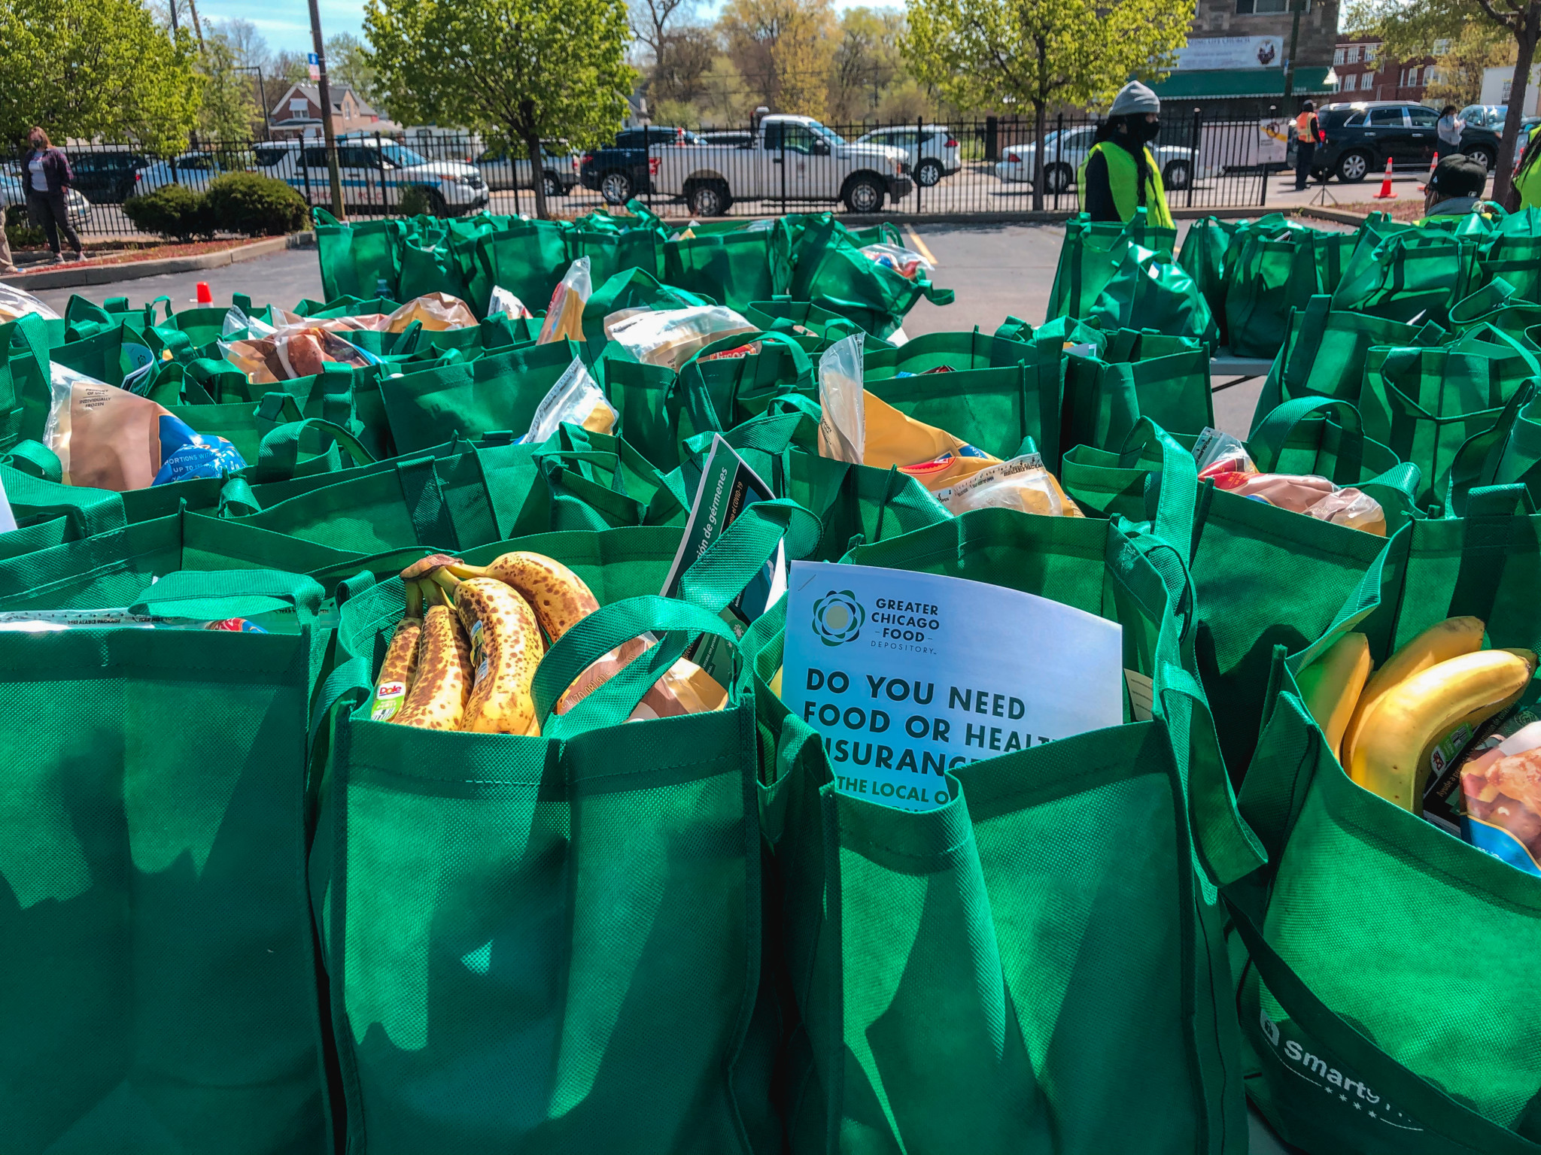
Goals of the Project
Predict food item demand using historical data and demographics
Efficiently manage and optimize food inventory
Provide updates on inventory levels and distribution progress
Accommodate the growth of the food bank network and increased demand over time
Notes:
Predict food item demand using historical data and demographics

Slide 5

Why do we need this?
Streamline operations,
Better decision making
Scalability for food banks.
Improved access for underprivileged communities
Notes:
Streamline operations to reduce waste and ensure that resources are being used correctly
Enables food banks to make informed decisions
Scalability for food bank to be able to grow and match increasing demand
Improved Access for underprivileged communities and fight food insecurity

Slide 6

Scope of our Work
Predicts food demand based on historical data,
demographics, and factors.
Efficiently manages and optimizes food inventory.
Provides live inventory, distribution, and demand updates.
Generates analytics for assessing impact, identifying trends, and informed decision-making.

Slide 7
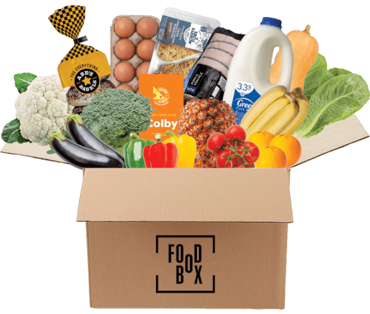
Scope of the Product
Machine Learning-Powered Tool
Utilizes machine learning algorithms.
Predicts supply and demand of various resources.
Optimized Distribution Strategy
Recommends the best distribution strategies.
Aims for maximum reach and efficiency in food allocation.

Slide 8
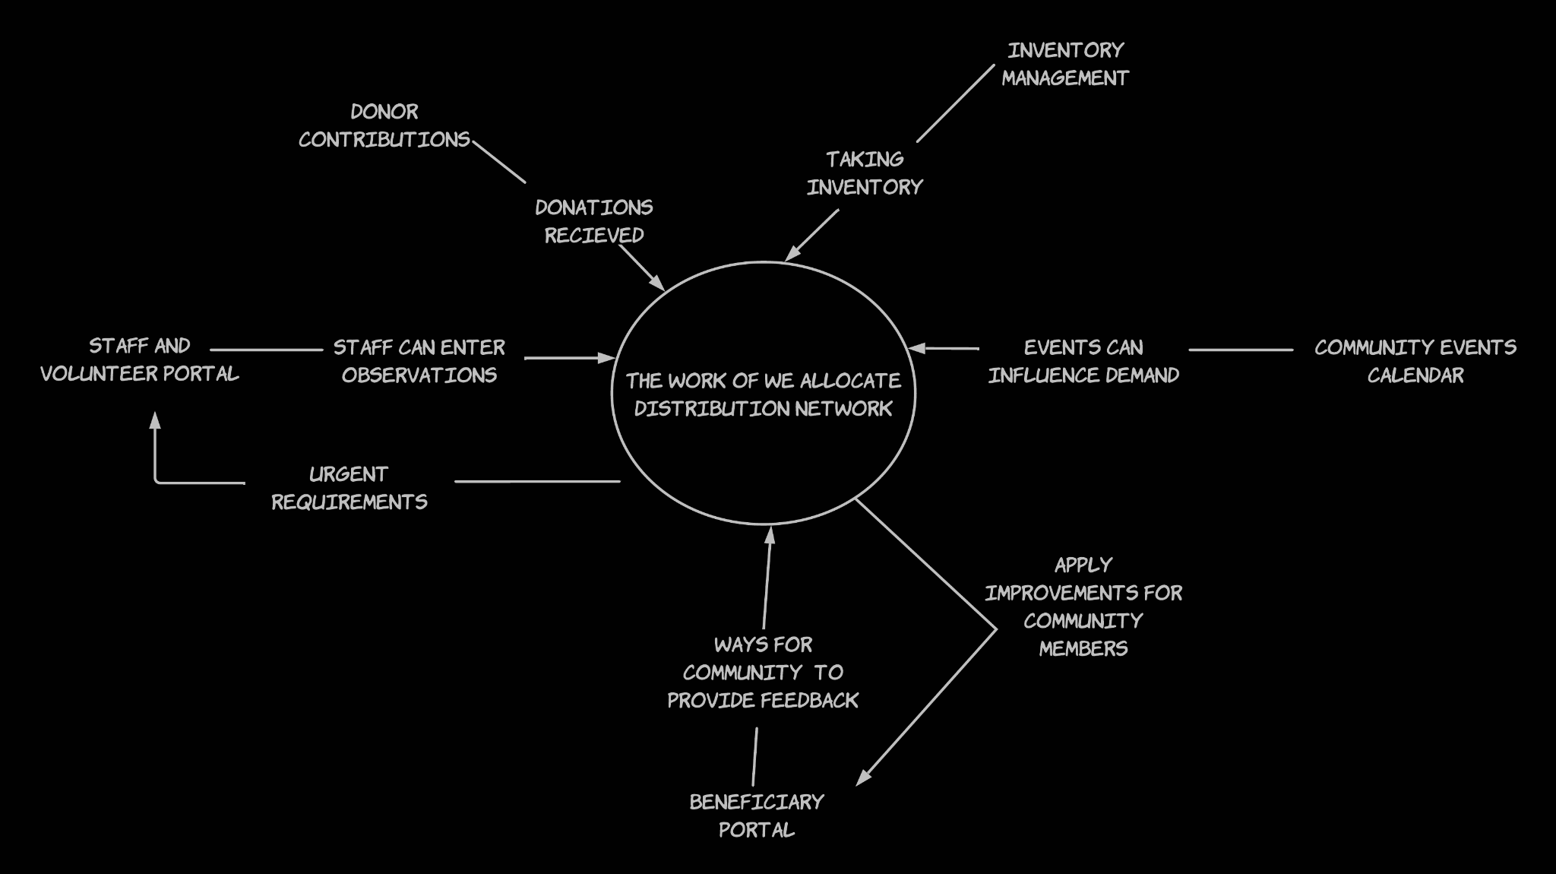




Context Diagram
Notes:
Context DIAGRAM

Slide 9
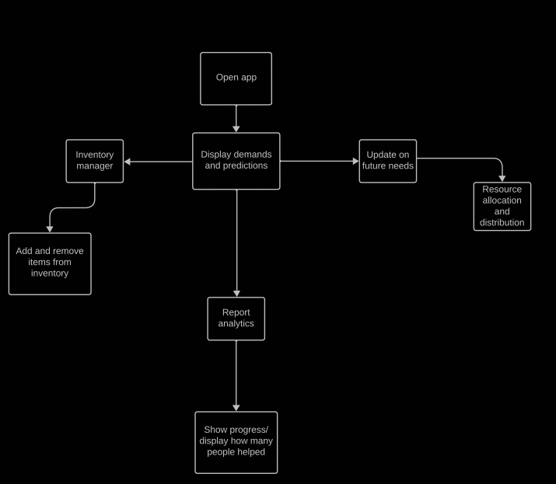
Initial Scenario Diagram

Slide 10

Constraints
Cloud-based application accessible via web browsers due to limited hardware capability of IMAN
Feature a user-friendly dashboard with interactive data visualization capabilities
Incorporate role-based users to allow different degrees of user access
Designed with scalability in mind to ensure permanent foundation of community support
Ideally launch before peak season
Funding is limited due to non-profit status of IMAN and reliability of grants/donations

Slide 11
Naming
Allocation Algorithm: The specific machine learning method used by WeAllocate to distribute resources within the IMAN food bank.
Dashboard: The user interface of WeAllocate that presents data, allocation results, and system functionalities in an organized manner.
Database: A structured collection of data in WeAllocate, storing information about resources, allocations, users.
IMAN: Abbreviation for "Inner-City Muslim Action Network" The organization for which WeAllocate is being developed to manage and optimize the allocation of its resources.
Resource: Any tangible or intangible item managed by IMAN, such as food items or volunteer hours, that requires allocation via WeAllocate.

Slide 12
Facts Assumptions
IMAN serves the inner-city communities of Chicago, including marginalized groups, low-income families, and individuals from various ethnic backgrounds.
The Food and Wellness Center operates six days a week, providing both fresh produce and non-perishable food items
Engages with the community through health workshops, nutritional education sessions, and community-building events.
Collaborates with businesses and other organizations for food sourcing
Significantly supported by community volunteers.
infrastructure comprising storage facilities, refrigeration units, and community spaces where beneficiaries and volunteers interact.
Volunteers and staff at IMAN's Food and Wellness Center, have basic computer literacy.
stable internet connectivity and devices
Existing data related to food inventory, beneficiaries, and other relevant metrics
Volunteer will commit to using the system consistently.
Allocate necessary resources, both in terms of time and finances for deployment of WeAllocate.
The community will positively receive the introduction of a digital system, understanding it as a move towards efficiency and better service.
Notes:
Daniyal: This IMAN operates 6 days a week to provide. Other than just providing food they host workshops regarding health and nutritions

Slide 13
How does this application help IMAN food and wellness center ?
Help IMAN optimize their food distribution operations
Manage their food inventory more effectively
Real-time updates on resource allocation trends
Data Driven Decisions for a stable future
Forecast demand to accommodate community events
Assist with managing larger scale community support

Slide 14
Naming conventions
Beneficiaries: The primary end-users of the resources allocated by WeAllocate. Their needs can vary based on individual circumstances, seasonality, and community events. Understanding their consumption patterns, preferences, and feedback is crucial for optimizing resource allocation.
Staff and Volunteers: directly interacting with beneficiaries and handling the day-to-day operations of the Food and Wellness Center. Their insights, observations, and feedback are needed for refining the WeAllocate system. They can also identify anomalies or urgent requirements that might not be immediately evident from data alone.
Donors: Entities or individuals donating food items or funds to IMAN's Food and Wellness Center.
Community Events: Local events, holidays, or community gatherings can influence demand.
Inventory Management: IMAN's Food and Wellness Center might be using existing systems for inventory management, feedback collection, or donor management. Ensuring seamless integration with these systems is crucial for the holistic functioning of WeAllocate.

Slide 15
Sources
https://www.imancentral.org/chicago/
https://www.foxbusiness.com/economy/food-banks-serving-more-people-inflation
https://www.chicagosfoodbank.org/blog/in-west-englewood-a-new-food-pantry-opens-at-corner-of-hope-and-heartache/
https://www.imancentral.org/chicago/organizing-advocacy/food-ecosystems/
https://map.lisc-cnda.org/2022/cnda/the-iman-food-and-wellness-center
https://abc7chicago.com/hunger-chicago-englewood-food-pantry/11309013/

